Slide 1
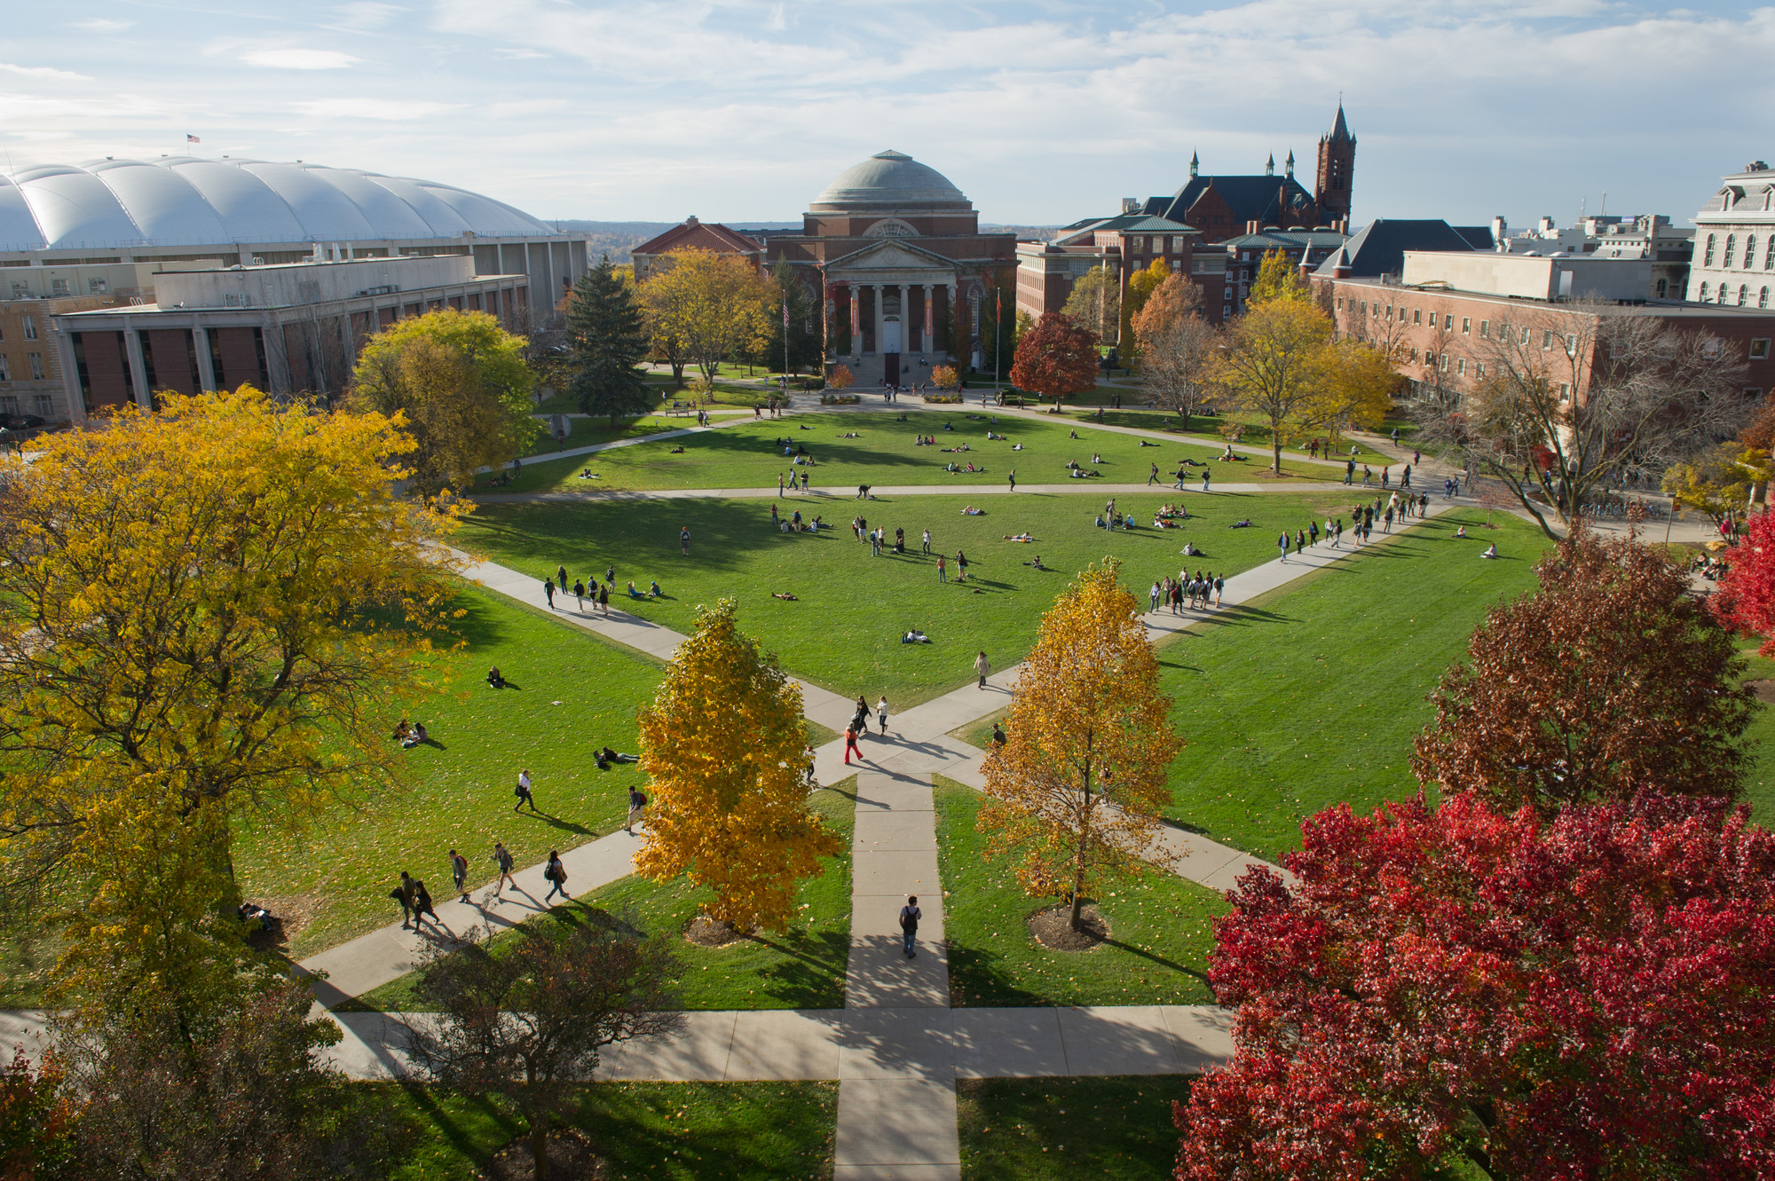
IST769 Advanced Big Data Management

Slide 2

Agenda
Introductions & Syllabus
Ice Breaker Activity
Quick IST659 Review
Course Setups

Slide 3
Intro, Blackboard & Syllabus

Slide 4

What Happens in Class?
Go over the homework
Ask and answer questions
Share solutions
Discussion on the Assigned Readings
Might be an organized activity
Lecture Topic
Slides
Questions / Discussion
Demos

Slide 5

Homework
You might not get it correct
This is acceptable
What is not acceptable is not trying
You will be expected to reflect on your learning
To me your reflection is more valuable than your answers
It is about learning and seeing your growth as a learner

Slide 6
Ice Breaker Activity

Slide 7

Pair-Share
5 minutes:
Find a Partner
Introduce yourselves
Find two things in common (besides your studies)
After:
Go around room
Introduce your partner
Share one of the 2 things you have in common

Slide 8
IST659 Review

Slide 9
IST659 Takeaways Important to This Course
SQL Operations
Indexing
Transactions
Database Applications

Slide 10

SQL Operations
SELECT a,b, sum(c) FROM x WHERE a =‘Y’
GROUP BY a,b
Order the steps of this SELECT statement, first to last
What is a map? Which operation performs a map?
What is a reduce? Which operation performs a reduce?

Slide 11

Indexing
What is an index?
What is the difference between a clustered and non-clustered index?
How do you know when an index is being used?
SELECT c, sum(g) FROM x GROUP BY c SELECT a,b FROM x WHERE c=7 Write one index to cover both queries.

Slide 12

Transactions
What is a database transaction?
What is Atomicity?
What is Consistency?
What is Isolation?
What is Durability?
What is a Rollback?

Slide 13

Database Applications
What is the presentation layer?
What is the business logic layer?
What is CRUD?
What is the difference between business logic and data logic?
Provide an example of business logic
Provide an example of data logic

Slide 14
Course Setups

Slide 15
GET SETUP FOR IST769
Windows 10 Pro or Mac OSX
A Computer with 8 GB RAM Minimum, 40GB Free Disk
Instructions: https://mafudge.github.io/ist769/content/A-Intro/

Slide 16

Demo
Docker commands

Slide 17
Summary Docker Concepts
Image – file on disk representing an application or service
Container – a running image
Dockerfile – instructions to build an image
Docker-compose – method run multiple containers together
Ports – TCP or UDP ports exposed from a running container; a means to access the service!
Volumes – files or folders that persist among multiple runs of a container

Slide 18

Questions?

